Slide 1



Multiple Myeloma
University of Salamanca
María-Victoria Mateos
University Hospital of Salamanca- IBSAL
Salamanca. Spain

Slide 2
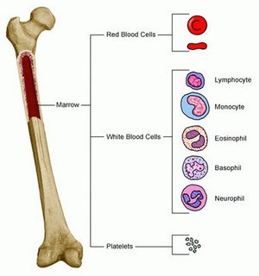
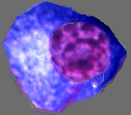
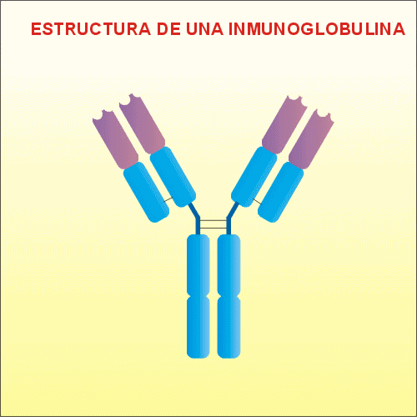
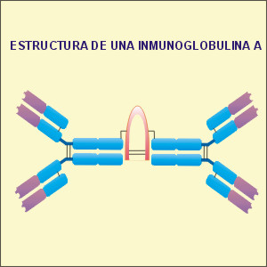
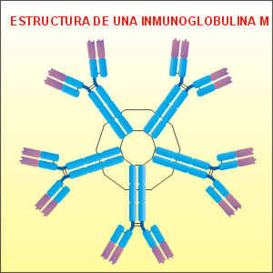
MM: plasma cell disorders
Plasma cell
IgG
IgA
IgM
Notes:
Which is the origin, which is the responsible of the plasma cell disorders??
PLasmacel

Slide 3
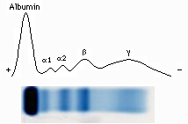
Protein Serum electrophoresis
IgG
IgA
IgM
Normal Serum electrophoresis: Proteinogram

Slide 4
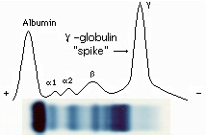
Protein Serum electrophoresis
IgG
IgG
IgG
IgG
IgG
IgA
IgM
Normal serum electrophoresis
Serum M-protein:
Monoclonal protein, M-spike
Notes:
Both plasma cell proliferation in the Bone marrow plus monoclonal component are key to do the diagnosis of plasma cell disorder

Slide 5
Myeloma-defining events
Monoclonal protein
BM infiltration
Decreased normal Igs: immunodeficiency
Amyloidosis
Anemia
73%
Hyperviscosity
Cytokine release
Infections
Renal failure
Bone destruction
78%
Hypercalcemia
Neurologic
Bone pain
Hypercalcaemia: serum calcium >0.25 mmol/L (>1 mg/dL) higher than the upper limit of normal or >2.75 mmol/L (>11 mg/dL)
Renal insufficiency: creatinine clearance <40 mL per min† or serum creatinine >177 μmol/L (>2 mg/dL)
Anaemia: haemoglobin value of >20 g/L below the lower limit of normal, or a haemoglobin value <100 g/L
Bone lesions: one or more osteolytic lesions on skeletal radiography, CT, or PET-CT‡
Rajkumar et al. Lancet Oncology 2014; 15: e538-48

Slide 6
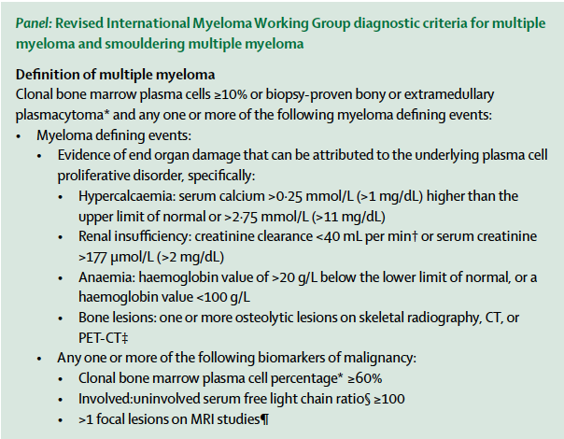
Rajkumar et al. Lancet Oncology 2014; 15: e538-48

Slide 7
Multiple Myeloma
Second most common hematological malignancy
  Incidence: ~4-5/100,000 persons/year (2000 new cases per year
  in Spain)
  Prevalence: 60,000 pts (Europe))
  Incidence increases with age: 80% of patients >60 years
  (rare in < 35 y.)
Race | Male | Female
All races | 7.4 per 100,000 | 4.7 per 100,000
White | 6.9 per 100,000 | 4.1 per 100,000
Black | 14.3 per 100,000 | 10.1 per 100,000
SEER incidence and NCHS mortality statistics. Available at: http://seer.cancer.gov/statfacts/index.html.
Accessed August 2012.

Slide 8
Plasma Cell disorders
MGUS/Smoldering MM
Multiple Myeloma
Macroglobulinemia de Waldenström
Amiloidosis
POEMS
Malign
Benign
10-20 % of benign monoclonal gammopathies evolve to MM

Slide 9
Natural History of Multiple Myeloma
Asymptomatic
Symptomatic
100
ACTIVE MYELOMA
2. RELAPSE
REFRACTORY RELAPSE
M-protein (g/L)
1. RELAPSE
50
MGUS or smoldering myeloma
20
Plateau remission
First-line therapy
Second-line
Third-line
MGUS=monoclonal gammopathy of undetermined significance.
Notes:
9

Slide 10
Plasma cell discrasias: diagnostic criteria
Monoclonal
Gammopathy of
uncertain significance
(MGUS)
Smouldering
Multiple
Myeloma
(SMM)
Multiple
Myeloma
Monoclonal
component
Bone Marrow
Plasma Cells (%)
Myeloma-defining eventª
< 3 g/dL serum
AND
< 10%
AND
Absent
≥3 g/dL serum
AND/OR
10-60%
AND
Absent
Present
(serum/urine)
AND
> 10%^{b}
AND
Present

Slide 11
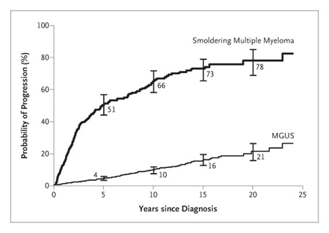
MGUS/Smoldering Multiple Myeloma:
Risk of progression to active disease
1%
3%
10%
Are there any risk factors predicting progression to active disease?
Kyle R. N Engl J Med 2007; 356:2582-90
Notes:
And you can show him this picture explaining him that .....
The next question from the patient would be: are you able toidentify if I am in this group, in this.other or in the high risk subgroup??
And your answer should beYEs. I can do and this is the next step

Slide 12
Curative Estrategia Smoldering Alto Riesgo (CESAR trial) (n:90)
Induction 6 cycles of KRd
MRD
ASCT (melphalan 200)
MRD
Consolidation (2 cycles of KRd)
MRD
Maintenance (Len-dex for 2yrs)
MRD
Primary objective: To evaluate the proportion of patients in sustained immunophenotypic response at 5 years
Hypothesis: At least 50% of patients will achieve the objective
20 centers

Slide 13
Recommended work up at diagnosis
Medical History and physical examination
Hemogram
Biochemistry: Creatinine and calcium values Albumin and Beta2 microglobuline*
Protein studies - Total serum protein and serum electrophoresis (serum M-protein) - 24-h urine protein electrophoresis (urine M-protein) - Serum and urine immunofixation
Bone Marrow aspirate+/- biopsy: Morphology, flow cytometry, FISH analysis
Skeletal survey/other imaging techniques
* ISS stage
Dimopoulos MA. Blood 2011; 117(18)

Slide 14
International Staging System
Greipp PR. JCO 2005

Slide 15
Recommended work up at diagnosis
Medical History and physical examination
Hemogram
Biochemistry: Creatinine and calcium values Albumin and Beta2 microglobuline*
Protein studies - Total serum protein and serum electrophoresis (serum M-protein) - 24-h urine protein electrophoresis (urine M-protein) - Serum and urine immunofixation
Bone Marrow aspirate+/- biopsy: Morphology, flow cytometry, FISH analysis
Skeletal survey/other imaging techniques
* ISS stage
Dimopoulos MA. Blood 2011; 117(18)

Slide 16
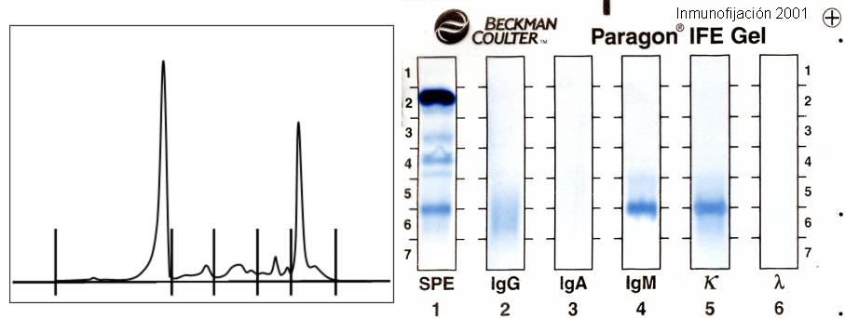
Serum electrophoresis and immunofixation
IgM
IgG

Slide 17
Recommended work up at diagnosis
Medical History and physical examination
Hemogram
Biochemistry: Creatinine and calcium values Albumin and Beta2 microglobuline*
Protein studies - Total serum protein and serum electrophoresis (serum M-protein) - 24-h urine protein electrophoresis (urine M-protein) - Serum and urine immunofixation
Bone Marrow aspirate+/- biopsy: Morphology, flow cytometry, FISH analysis
Skeletal survey/other imaging techniques
* ISS stage
Dimopoulos MA. Blood 2011; 117(18)

Slide 18
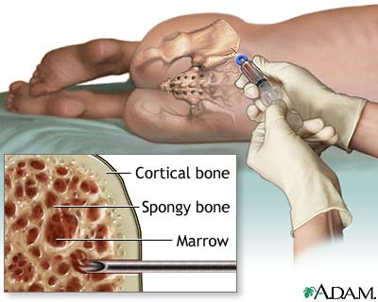
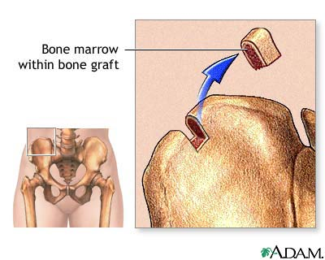
BM aspirate
BM biopsy

Slide 19
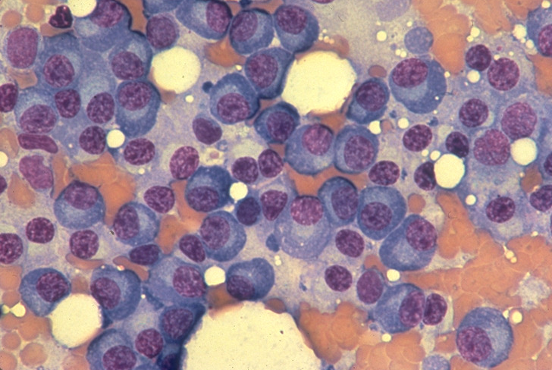
BM aspirate: morphology

Slide 20
Flow cytometry: PCs immunophenotype
Abnormal plasma cells
Normal plasma cells
Notes:
Personal identity of the plasma cells through the identiication of antigens that they are in the cell surface

Slide 21

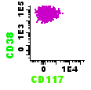
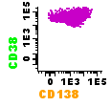
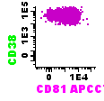
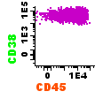
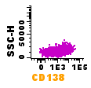
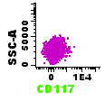
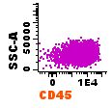
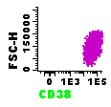
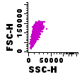
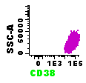
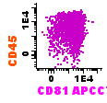
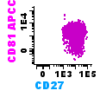
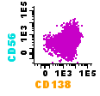
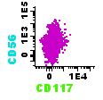
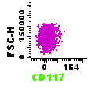
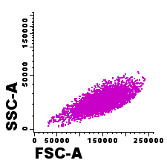
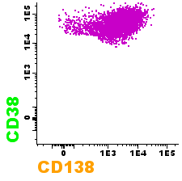
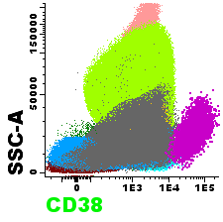
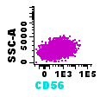
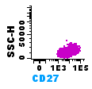
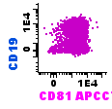
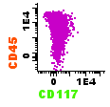
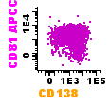
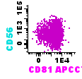
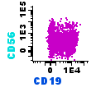
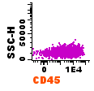
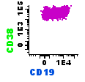
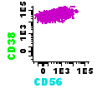
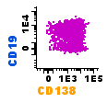
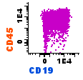
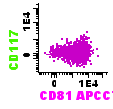
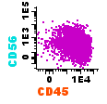
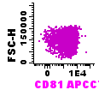
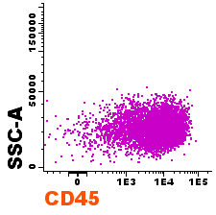
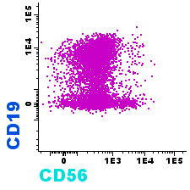
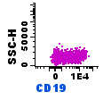
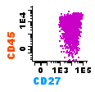





































IMMUNOPHENOTYPIC CHARACTERISTICS OF NORMAL vs LEUKEMIC B-CELLS
CD38^{hi}
CD138⁺
Plasma cells
8- COLOR flow cytometry: multiple myeloma MRD EuroFlow panel (72 bivariate plots/tube)
Reference
Normal
Plasma cells
Notes:
21

Slide 22


Cytogenetic abnormalities
IgH Tx: t(4;14), t(14;16), t(14;20)
17p del
gain 1q/del1p
Conventional cytogenetic
Utility for detection of non-hyperploid karyotype
FISH

Slide 23
High risk Cytogenetics in Myeloma
(FISH on separated PC)
Negative
- t (4;14), t(14;16), t(14;20)
Del (17) or del (17p)
1q gains/1p deletions
Non-hyperdiploid karyotype
Combinations of three or more of these abnormalities identify ultra-high risk patients
IMWG manuscript in preparation. 2015

Slide 24
Recommended work up at diagnosis
Medical History and physical examination
Hemogram
Biochemistry: Creatinine and calcium values Albumin and Beta2 microglobuline*
Protein studies - Total serum protein and serum electrophoresis (serum M-protein) - 24-h urine protein electrophoresis (urine M-protein) - Serum and urine immunofixation
Bone Marrow aspirate+/- biopsy: Morphology, flow cytometry, FISH analysis
Evaluation of the bone disease
* ISS stage
Dimopoulos MA. Blood 2011; 117(18)

Slide 25
Imaging asessments for bone disease
Technique | Radiation dose | Bone | Tumor burden | Treatment monitoring | Examination Time
X-ray | 2-4 mSv | + | o | o | 30-45 min
Low-dose CT | 4-7.5 mSv | ++ | + | + | 10 min
PET-CT | 17-25 mSv | ++ | + | ++ | 120 min
MRI | 0 mSv | (+) | ++ | + | 45 min
MM: Low dose CT + Xray Skull; PET-CT with uptake in PET and lession in CT
MRI of Spine for SMM

Slide 26
Summary of a patient record
57 years old man
MM Ig G-Kappa, ISS 2
MC: 3.4 g/dL; BJones negative
PCBM infiltration: 35% (100% clonal and pathologic). FISH normal
Anemia: 8.9g/dL; Lytic lesions in skull and femurs;
Positive uptake in PET-CT in both femurs (third superior)
No hypercalcemia; normal renal function

Slide 27
Individualizing Treatment in the Era
of Novel Agents
Stratification
Age
(< or > 65/70 y)
Risk Factors
- Cytogenetics
- ISS
- Renal function
- LDH
- Labeling index
- Extramedullary disease
Standard vs High Risk
Transplant
or non-transplant candidate

Slide 28
Myeloma Treatment
Current Status and future directions
  - The newly diagnosed
-The Transplant candidate patient (Young)
-The Non-Transplant candidate patient (Elderly)

Slide 29
Management of NDMM: Role of depth of response
Depth of response Time to progression
Treatment Initiation
MR
PR
VGPR
nCR
CR
sCR
iCR
Time
Depth of response is related to TTP, PFS and OS
MR, minimal response; sCR, stringent complete response; iCR, immunophenotypic CR; TTP, time to progression.
Niesvizky R, et al. Br J Haematol. 2008;143(1):46-53. Harousseau JL, et al. Haematologica. 2010;95(10):1738-1744. Dimopoulos MA, et al. Leukemia. 2010;24(10):1769-1778.

Slide 30
Maximal Eradication of Tumor
Clone Through Achievement of Best Possible Response
Prognostic impact of CR vs nCR/VGPR/PR vs
SD/PD after high-dose therapy plus ASCT (n=344)
PFS
OS
1.0
1.0
0.9
P=0.00001
0.9
P=0.00001
0.8
0.8
0.7
0.7
0.6
0.6
0.5
OS (%)
0.5
CR
PFS (%)
CR
0.4
0.4
0.3
0.3
nCR + VGPR + PR
0.2
SD + PD
nCR + VGPR + PR
0.2
SD + PD
0.1
0.1
0.0
0.0
0
5
10
15
20
0
5
10
15
20
Years
Years
CR, complete response; nCR, near complete response; VGPR, very good partial response; PR, partial response; SD, stable disease; PD, progressive disease; ASCT, autologous stem cell transplantation.
Martinez-Lopez J et al. Blood. 2011;118:529.
Notes:
Curatio Fact Check
Taken directly from Martinez-Lopez et al, pg 532, figure 2
**PERMISSION REQUIRED FOR HANDOUT**

Slide 31
GEM2005MAS65: VMP/VTP→VT/VP
Impact of response in the whole series of patients (n:260)
Median f/u: 72 m (6yrs)
PFS
OS
1,0
1,0
CR: 80m
0,8
CR: 55m
0,8
0,6
0,6
Proportion of pts
Proportion of pts
<CR: 50m
0,4
0,4
<CR: 24m
0,2
0,2
0,0
HR: 2,76 (95% CI: 1,94-3,94) p<0,0001
0,0
HR: 2,26 (95% CI: 1,47-3,48) p<0,0001
0
10
20
30
40
50
60
70
80
90
0
10
20
30
40
50
60
70
80
90
Time in months
Time in months
The benefit of CR was more evident for VMP than VTP arm
Mateos et al. Blood 2014; Aug 7. [Epub ahead of print]
Notes:
The poor outcome was observed in pts receivng VTP as induction followed by VT as maintenance

Slide 32
Important Aim of Treatment
CR should be an important objective in patients with multiple myeloma
MRD evaluation is a relevant prognostic factor in the management of NDMM patients
Achievement of high-quality, sustained CR balanced with acceptable toxicity

Slide 33
Transplant candidate patient:
Induction
ASCT
Maintenance
Notes:
PHENOTYPE OF WM B-LYMPHOCYTE

Slide 34
Is There Something Better Than VAD?
Responses obtained with novel induction regimens
100
90
80
70
60
ORR
Percent Response
50
CR
40
30
20
10
0
VAD
TD
TAD
LD
BzD
BzTD
VRD
VRDC
Induction Regimen

Slide 35
Bz + IMiD-Based
Induction Regimens
Induction Regimen | Study Details | Response Postinduction | Response Post-ASCT | PFS (months) | OS
 |  | CR (%) | CR (%)
VTD vs TD¹ | Phase 3: VTD vs TD as induction and consolidation | 19* 5 | 42* 30 | 68%* 56% (3-yr) | 86% 84% (3-yr)
VTD vs TD² | Phase 3: VBMCP/VBAD + V vs TD vs VTD induction + α-IFN, thal or thal/bortezomib maintenance | 35* 14 | 46* 24 | 56* 28 | 75% 65% (4-yr)
vtD vs VD³ | Phase 3: comparison of doublet vs triplet induction regimens | 13 12 | 29 31 | 26 30 | NS
RVD⁴ | Phase 2: RVD induction HDM and consolidation | 23* | 42* | Not reported
*P value statistically significant
1. Cavo et al. Lancet 2010;376:2075-85.
2. Rosinol L et al. Blood . 2012;120:1589.
3. Moreau P et al. Blood. 2011;118:5752.
4. Roussel M et al. Blood. 2011;118: Abstract 1872.
Notes:
Curatio Fact Check
Row 1: First column data same as presented on slide 13; column 2, CR data based on post second ASCT; PFS, OS OK per pg 6, col 2
Row 2: First column data same as presented on slide 13; column 2 OK per abstract; PFS should be 56 vs 28; OS is reported as 4-yr and 75% for VTD and 65% for TD (NS); why not reported?
From Dr Mateos: You can put the PFS and OS but these time to event data were not an objective of the trial because patients after transplant, some received consolidation and maintenance, other only maintenance, other nothing,..
Row 3: First column data same as presented on slide 13--Need to change the comparative arm from “TD” to VD; column 2 OK per table 2, pg 5755; PFS and OS were mentioned in the article so why “not reported”? (see page 5756, col 1) – no difference in PFS (med 30 mos VD vs 26 mos in vtD); no sign difference in OS.
Row 4: First column data same as presented on slide 14; col 2 OK per abstract table, but unclear what the statistical significance is for; PFS/OS, OK as not reported in abstract
For the data referring to the Moreau et al study, we need to change the comparative arm from “TD” as it is currently labeled to “VD”
Per Dr Mateos: OK.
Would it be acceptable to make the following updates?: Per Dr Mateos: OK
· For the Rosinol data row: PFS should be 56 vs 28; OS is reported as 4-yr and is 75% for VTD and 65% for TD (NS)
· For the Moreau data row: PFS and OS were mentioned in the article so why “not reported”? (see page 5756, col 1) – no difference in PFS (med 30 mos VD vs 26 mos in vtD); no sign difference in OS.
Per Dr Mateos: You can put the PFS and OS but these time to event data were not an objective of the trial because patients after transplant, some received consolidation and maintenance, other only maintenance, other nothing,..

Slide 36



Bortezomib-Based Versus Nonbortezomib-Based Induction: A Meta-Analysis of Phase III Randomized, Controlled Trials (2086 pts)
Overall Survival, (%)
Bz-based induction results in significant improvements in PFS/OS compared wih nonbortezomib-based induction
Sonneveld P et al. JCO 2013; 31: 3279-87

Slide 37
Is There Something Better Than VAD?
Responses obtained with novel induction regimens
100
ORR
90
CR
80
70
60
50
Percent Response
40
30
20
10
0
VAD
TD
TAD
LD
BzD
BzTD
VRD
KTD
KRD
Induction Regimen

Slide 38
Transplant Candidate:
Standard Treatments
Induction (PI+IMiD’s)
+ bortezomib
ASCT (melphalan 200)
+ busulfan
Maintenance
Lonial S et al. Clin Cancer Res. 2010;16:5079.
Lahuerta JJ et al. Haematologica. 2010;95:1913.

Slide 39
Aims of Consolidation or Maintenance Therapy
Consolidation
Maintenance
Improve response/induce deeper response following therapy
  By administration of treatment for a limited period
Maintain response achieved following therapy
  By administration of
  treatment for a prolonged period
Reduce the risk of relapse
Extend PFS and OS

Slide 40
Consolidation Therapy
Induction Regimen | Response Post-VTD Induction | Response Post-ASCT | Response Post-Consolidation | PFS | OS
 | CR (%) | CR (%) | CR (%)
VTD¹ | 19 | 42 | 61 | 60% (3-yr) | 90% (3-yr)
RVD² | 23 | 42 | 48
KTD³ | 25 | 33 | 63
Consolidation upgraded response in approximately 30%.
Cavo M et al. Blood. 2012; 120:9.
2. Roussel M et al. Blood. 2011;118: Abstract 1872.
3. Sonneveld P et al. Blood 2014;
Notes:
Curatio Fact Check
Row 1:CR post indicution should be 22.5% per table 2, pg 13; CR post ASCT which one? First [43.8%]? Second [48.7%]?; CR post consolidation is 60.6% [OK]; PFS should change to 60% per abstract and page 13, col 1; 90% at 3-yr for OS, page 14, col 2
Row 2: OK per abstract table
Would it be acceptable to make the following updates?:
For the Cavo data row: CR post indicution should be 22.5% per table 2, pg 13; CR post ASCT which one? First [43.8%]? Second [48.7%]? Per Dr Mateos: After second ASCT
PFS should change to 60% per abstract and page 13, col 1; 90% at 3-yr for OS, page 14, col 2
Per Dr Mateos: OK
PSCM Comment: Ref #2 is preliminary data from a small Phase II trial.

Slide 41
Thalidomide Maintenance Treatment
 | Significant improvement in PFS with maintenance therapy | Significant improvement in OS with maintenance therapy | Survival after relapse
Spencer | Yes | Yes (5 years follow up) | Similar in all groups
Attal | Yes | Yes (@ 39 m), but OS advantage disappeared with longer follow-up (5.7 years) | Similar in all groups
Barlogie | Yes | Yes (7.2 years follow-up) | Reduced OS after thal
Lokhorst | Yes | No | Reduced OS after thal
Morgan | Yes | No | Reduced OS after thal
Stewart | Yes | No | Reduced OS after thal
1. Attal M, et al. Blood. 2006;108(10):3289-3294. 2. Spencer A, et al. J Clin Oncol. 2009;27(11):1788-1793.
3. Barlogie B, et al. N Engl J Med. 2006;354(10):1021-1030. 4. Morgan GJ, et al. Blood. 2009;114: Abstract 352.
5. Lokhorst HM, et al. Blood. 2010;115(6):1113-1120.
Notes:
Results from IFM200502 aren’t pending because they have just been presented at ASCO meeting. I have deleted that sentence

Slide 42
Lenalidomide vs Placebo After ASCT
PFS From Randomization
IFM 2005-02^{[1]}
CALGB 100104^{[2]}
100
1.0
Lenalidomide
(med 41 mos)
0.8
75
Lenalidomide
(med 46 mos)
0.6
PFS (%)
50
Probability of PFS
0.4
Placebo
(med 23 mos)
Placebo
(med 27 mos)
25
0.2
P<0.001
Two-sided P<0.001
0
0.0
0
6
12
18
24
30
36
42
48
0
10
20
30
40
50
60
70
Months of Follow-up
Months Since Autologous HSCT
OS: >70% at 4 y in both arms
OS: 35 vs 53 deaths, P=0.03
1. Attal M et al. N Engl J Med. 2012;366:1782.
2. McCarthy PL et al. N Engl J Med. 2012;366:1770.
Notes:
This result is illustrated on this slide
The PFS from randomization of patients treated with revlimid arm or in the placebo arm
Curatio Fact Check
LEFT GRAPH: Taken directly from Attal et al, figure 1A, pg 1788---this graph needs to be updated with the image in the published article (x-axis goes out to 48 months); don’t know where the 83% OS value is coming from. Article says more than 70% of pts in both groups were alive at 4 yrs.
RIGHT GRAPH: Taken directly from McCarthy et al, figure 1A, pg 1775--this graph needs to be updated with the image in the published article and the new graph represents PFS not TTP. Need to update the deaths…
**PERMISSION REQUIRED FOR Handout **

Slide 43
Bortezomib maintenance therapy
PAD + HDM + bortezomib maintenance (2 yrs) vs
VAD induction + HDM + thalidomide maintenance (2 yrs)
Study details | Median follow up | n | Results
 |  |  | ≥nCR | ≥VGPR | PFS | OS
PAD/HDM/Bortezomib vs VAD/HDM/Thalidomide | 39 m | 205 239 | 49%* 34% | 76%* 55% | 36 m* 27 m | Median not reached HR=0.73 (0.56-0.96) p=0.02
*significant difference between arms
Maintenance VT vs Thal vs Interferon-α2b (3 yrs)
Phase 3 PETHEMA/GEM trial
 | VT | Thal | Interferon-α2b | p
PFS @ 2 years | 78% | 63% | 49% | 0.01
Sonneveld et al. ASH 2010 (Abstract 40), oral presentation
Rosinol et al. ASH 2011 (Abstract 3962), poster presentation

Slide 44
Best response to treatment in phase 2 patients receiving maintenance with ixazomib after Ird as induction (n=21)
n=2
n=1
10 (48%) patients improved their response during maintenance:
  2 VGPR to nCR, 5 VGPR to CR, 1 VGPR to sCR, and 2 CR to sCR
Kumar et al. ASH 2014 (Abstract 82), oral presentation

Slide 45
Is there a role for
maintenance therapy in MM??
Yes.................... but.................. Uncertainness
- For whom
We don’t know - For how long
- How to monitor efficacy
- Aim

Slide 46
Conclusions
Bortezomib-based combinations are the standard of care for induction in young NDMM patients
Number of cycles undecided: between 4-6
Mel200 followed by ASCT remains the standard of care
PostASCT strategies pending of confirmation
Tandem ASCT for high-risk patients
Notes:
All these trials are in clinicaltrials.gov
The purpose is to indicate that there are new trials incorporating novel proteasome inhibitors/monoclonal antibodies

Slide 47
Conclusions
Proteasome inhibitors-based combinations are the standard of care for induction in young NDMM patients
Number of cycles undecided: between 4-6
Mel200 followed by ASCT remains the standard of care
PostASCT strategies pending of confirmation
Tandem ASCT for high-risk patients
Notes:
All these trials are in clinicaltrials.gov
The purpose is to indicate that there are new trials incorporating novel proteasome inhibitors/monoclonal antibodies

Slide 48
Myeloma Treatment
Current Status and future directions
  - The newly diagnosed
-The Transplant candidate patient (Young)
-The Non-Transplant candidate patient (Elderly)

Slide 49






Elderly MM patients are an heterogeneous group
Mildly frail:
Help for household tasks
Moderately fit:
Not regularly active but
Routinely walking
Very fit:
active, who exercise regularly
Severely frail:
Dependent on other people
Vulnerable:
Can perform limited activities but
they don’t need any help
Moderately frail:
Partial help for their personal care
Palumbo A. Blood 2011; 118:4519-29

Slide 50

Charlson index
ADL score
IADL score
Notes:
50

Slide 51


Treatment of elderly MM patients
MP plus Thalidomide
Median OS benefit: 7m
MPT: 20m
MPT: 39m
MP: 32m
MP: 14m
P<0,0001
P=0,004
Fayers P M et al. Blood 2011;118:1239-1247
Notes:
We come from MP with median survivals of approximately 2 years

Slide 52
Treatment of elderly MM patients
MP plus Bortezomib (VMP)
TTP
OS
100
100
90
80
70
60
50
40
30
20
10
0
VMP
MP
Median OS benefit: 13.3 m
80
60
Patients without event (%)
40
Median follow-up 60 months
Median OS:
VMP: 56m
MP: 43m, P=0.0008
20
VMP: 24.0 months
MP: 16.6 months, P<0.000001
0
0
3
6
9
12
15
18
21
24
27
0 6 12 18 24 30 36 42 48 54 60 66 72 78
Time (months)
Time (months)
Notes:
We come from MP with median survivals of approximately 2 years

Slide 53
FIRST: Phase 3 trial of Lenalidomide + low-dose Dex vs MPT (IFM 07-01; MM-020)
RANDOMIZATION
Rd (28-day cycle; until disease progression)
Lenalidomide 25 mg/day, days 1–21
Dexamethasone* 40 mg/day, days 1, 8, 15, and 22
Inclusion criteria
N = 1,623
Previously untreated MM
Age ≥ 65 years or not eligible
for a transplant
No neuropathy
of grade > 2
Rd (28-day cycle; up to 18 cycles)
Lenalidomide 25 mg/day, days 1–21
Dexamethasone* 40 mg/day, days 1, 8, 15, and 22
MPT (6-week cycle; up to 12 cycles )
Melphalan* 0.25 mg/kg/day, days 1–4
Prednisone 2.0 mg/kg/day, days 1–4
Thalidomide* 200 mg/day
Primary end-point: PFS
*In patients aged > 75 years: Dex 20 mg/day, melphalan 0.20 mg/kg/day, thalidomide 100 mg/day
Facon et al. N Engl J Med 2014;371:906-17.
Notes:
53
53
Tomorrow during the plenary session we will have the oprotunity to know the results of the FIRST trial, a randomized trial comparing Rd
Or even, we can combine alkylators based combiantion and non.alkylators based combinations in the same scheme
53

Slide 54
FIRST Trial: PFS
Continuous Rd reduced the risk of disease progression by 28% vs. MPT
100
 | Median PFS
Rd (n= 535) | 25.5 mos
Rd18 (n= 541) | 20.7 mos
MPT (n= 547) | 21.2 mos
80
Hazard ratio
Rd vs. MPT: 0.72; P = 0.0006
Rd vs. Rd18: 0.70; P = 0.0001
Rd18 vs. MPT: 1.03; P = 0.70349
60
Patients (%)
40
20
72 wks
0
0
6
12
18
24
30
36
42
48
54
60
Time (months)
Rd | 535 | 400 | 319 | 265 | 218 | 168 | 105 | 55 | 19 | 2 | 0
Rd18 | 541 | 391 | 319 | 265 | 167 | 108 | 56 | 30 | 7 | 2 | 0
MPT | 547 | 380 | 304 | 244 | 170 | 116 | 58 | 28 | 6 | 1 | 0
mos, months; MPT, melphalan, prednisolone, thalidomide; PFS, progression-free survival; Rd, Lenalidomide plus low-dose dexamethasone.
Facon et al. N Engl J Med 2014;371:906-17.
Notes:
Add number at risk and median

Slide 55
FIRST Trial: Overall Survival Interim Analysis
574 deaths (35%)
100
 | 4-year OS
Rd (n= 535) | 59.4%
Rd18 (n= 541) | 55.7%
MPT (n= 547) | 51.4%
80
60
Patients (%)
40
20
0
0
6
12
18
24
30
36
42
48
54
60
Overall survival (months)
Rd
Rd18
MPT
535
541
547
488
505
484
457
465
448
433
425
418
403
393
375
338
324
312
224
209
205
121
124
106
43
44
30
5
6
3
0
0
0

Slide 56
New standards of care for elderly MM patients
Alkylators-based regimens
Alkylators-free regimens
MP
IMiD’s
MPT
VMP
Len-dex
Six randomized trials:
Benefit in
PFS&OS...6m
One randomized trial:
Benefit in PFS...8m
OS...13m
One randomized trial:
Benefit in PFS&OS vs MPT
What is now the role of the alkylator?
Should we abandon melphalan?
Mateos MV. Educational Program ASH 2013
Notes:
MPT and MPV, as alkylator-based regimens are standards of care well known in the treatment of elderly newly diagnosed myeloma patients, and len-dex, although less known in non-US countries, will be in the near future a new standard.
What we wanted to do was to give the elderly myeloma patients PI, IMiD’s and alkylators, but not all at the same time, and

Slide 57
Options for elderly patients
Fit
Unfit
Frail
Karnofsky ≥80%/
Charlson index=0
Karnofsky 60%-80%
Charlson index ≤2
Karnofsky < 60%
Charlson index >2

Slide 58
Options for elderly patients
Fit
Unfit
Frail
Karnofsky ≥80%/
Charlson index=0
Karnofsky 60%-80%
Charlson index ≤2
Karnofsky < 60%
Charlson index >2
Alkylator-based comb
Non Alkylator-based comb
MPT
VMP
CyBorD
VTP
RVd
Rd until DP
Bz biweekly the 1st cycle and weekly thereafter; Bz SQ.
Thal doses up to 200mg
Len full doses
Cy at 500 mg/m² days 1, 8, 15
Melph full doses
Dex low doses: 40 mg weekly

Slide 59
Options for elderly patients
Fit
Unfit
Frail
Karnofsky ≥80%/
Charlson index=0
Karnofsky 60%-80%
Charlson index ≤2
Karnofsky < 60%
Charlson index >2
Alkylator-based comb
Non Alkylator-based comb
MPT
VMP
CyBorD
VTP/Vd
RVD x9c
Ld until DP
Bz weekly since the beginning; Bz SQ.
Thal doses not superior to 100mg.
Len 25 mg daily in Ld, but 15 mg in RVD
Cy 300 mg/m² days 1, 8, 15.
Melph reduced doses: 6-7 mg/m²
Dex reduced doses: 20 mg weekly

Slide 60
Options for elderly patients
Fit
Unfit
Frail
Karnofsky ≥80%/
Charlson index=0
Karnofsky 60%-80%
Charlson index ≤2
Karnofsky < 60%
Charlson index >2
Alkylator-based comb
Non Alkylator-based comb
CyTP
CyBorP
VMP lite
Vp
Ld until DP
Bz weekly since the first cycle; Bz SQ.
Thal doses not superior 50mg.
Len dose of 10-15 mg
Cy dose of 50 mg daily
Melph reduced doses
Prednisone instead of dex

Slide 61
CR should be the objective of the treatment in elderly MM patients and guide the treatment
Achievement of high-quality, sustained CR balanced with acceptable toxicity

Slide 62
Summary / Conclusions
VMP continues being one standard of care for the treatment of elderly patients with MM
Rd is the new standard of care
New combinations will emerge in the near future
CR should be the main objective, and the guide for the treatment…..
Dose adjustments should be considered based on age and comorbidities to enable optimal delivery of effective therapy
  Need simple geriatric scales and evaluation of quality of life
Numerous planned/ongoing studies addressing questions of optimal regimen, schedule, treatment duration and route of delivery....

Slide 63
Myeloma Treatment
Current Status and future directions
  - The newly diagnosed
-The Transplant candidate patient (Young)
-The Non-Transplant candidate patient (Elderly)
  - Relapse/refractory disease

Slide 64

Strategies at Relapse:
How to Make the Right Choice
Type of relapse
Efficacy of previous treatments
Toxicity of previous treatments
Further options

Slide 65
Strategies at Relapse after ASCT:
How to Make the Right Choice
Early relapse (<1 year post ASCT)--------------------------------5-10%
“Overcome drug resistance”
Combination of non-cross-resistant agents
VTD-PACE or VRD ± Dox + Cyclo → RIC-Allo
Intermediate relapse (1-3 years post ASCT)--------------------80%
“Prolong survival until curative treatments are developed”
Late relapse (>3 years post ASCT) --------------------------------10%
Reinduction + 2nd ASCT

Slide 66




New drugs and mechanisms of action in MM
CDK 1, 2, 5, 9 Dinaciclib
FGFR3 Dovitinib / AB1010 / MFGR 1877S
cKit /PDGFR Imatinib / Dasatinib
VEGF-R Bevacizumab
IGF-1R AVE1642 / CP-751, 851
EGF-R Cetuximab
PKC Enzastaurin
CS-1 Elotuzumab
CD38 Daratumumab / SAR650984
CD138 nBT062-DM4
CD56 Lorvotuzumab
CD40 Dacetuzumab / Lucatumumab
BAFF Tabalumab
KiR IPH2101
Kinase Inh.
MoAb
IL-6 Siltuximab
Lymph.
NK cell
Cell cycle Inh.
Ras
KSP Inh Arry-520
Aurora K Inh MLN8237
CDK 4/6 Inh Seleciclib
Raf
PI3K
IMIDs
MEK
Akt
Thalidomide
Lenalidomide
Pomalidomide
Alkylators
Melphalan
Cyclophosphamide
Bendamustine
Melflufen
mTORC1
mTORC2
MAPK
Signaling Pathways
AKT Perifosine / GSK2110183
mTORC1 Everolimus / Temsirolimus
mTOR C1/C2 MLN0128 / INK128
Farn Transf Tipifarnib
p38/MAPK inh SCIO-469
p38/JNK act Aplidin
MEK Selumetinib
Other DNA damaging
Proteasome Inh.
DACi
DNA Damaging Zalypsis
PARP Inhibitor Veliparib
Hypoxia act. Alkylator TH-302
Bortezomib
Carfilzomib
Ixazomib
Oprozomib
Marizomib
Panobinostat
Vorinostat
Romidepsin
Givinostat
Rocilinostat
Approved / Phase III development
Ocio, Leukemia 2014

Slide 67
Main Randomized Trials of Treatment of Relapsed/Refractory Myeloma
Approved combinations in Spain in 1st/2nd relapse
Regimen | ORR, % | CR, % | TTP, mo | OS
Bort vs Dex¹ | 38 vs 18 | 6 vs 1 | 6.2 vs 3.5 | 80% vs 66% at 1 year
Bort + Doxil vs Bort² | 44 vs 41 | 4 vs 2 | 9.3 vs 6.5 | 76% vs 65% at 15 months
Len/Dex vs Dex³ | 61 vs 19.9 | 14.1 vs 0.6 | 11.1 vs 4.7 | 29.6 vs 20.2 months
Len/Dex vs Dex⁴ | 60.2 vs 24 | 15.9 vs 3.4 | 11.3 vs 4.7 | Not reached vs 20.6 months
Carfilzomib^{5,6} Carfilzomib-len-dex, Pomalidomide^{7,8} & Panobinostat⁹ FDA-approved
Pomalidomide & Panobinostat & KRd⁹ EMA-approved
1. Richardson PG, et al. N Engl J Med. 2005;352:2487-2498.
2. Orlowski RZ, et al. J Clin Oncol. 2007:3892-3901.
3. Weber DM, et al. N Engl J Med. 2007;357:2133-2142.
4. Dimopoulos M, et al. N Engl J Med. 2007;357:2123-2132.

Slide 68
Bortezomib/Thalidomide-Lenalidomide: Background
In spite of this significant benefit…
Resistance to bortezomib-based therapy and lenalidomide can emerge over time
Some toxicities can limit its use and its potential effectiveness
We would need novel proteasome inhibitors and novel IMiDs
Notes:
I have shortened the first sentence in order to do not repeat again the same message

Slide 69
Proteasome Inhibitors: MoA
Caspase-L
β-subunit ring of the proteasome
Trypsin-L
Bortezomib
ixazomib
β1
β7
β2
Catalytic site
β6
β3
Marizomib
Three distinct N-terminal threonine protease active sites
β5
β4
Carfilzomib
oprozomib
Chymotrypsin-L
 | Type | Reversibility | PO/IV | Dosing | Phase
Bortezomib | Boronic | Reversible | IV | 1, 4, 8, 11 | Approved
Carfilzomib | Epoxi-ketone | Irreversible | IV | 1-2, 8-9, 15-16 | III
Ixazomib (MLN-9708) | Boronic | Reversible | PO | 1, 4, 8, 11 | III
Oprozomib (PR-047) | Epoxi-ketone | Irreversible | PO | BID | I
Carfilzomib and oprozomib no emergent or worsening PN; ixazomib some low grades (grade 1/2)

Slide 70
Carfilzomib Single Agent in Relapsed/Refractory MM: Summary Efficacy Data
PX-171-003 A0/A1¹: Relapsed after bortezomib and lenalidomide/thalidomide + refractory to last regimen
PX-171-004^{2,3}: Relapsed to 1 to 3 previous lines
Population | Study | N | Dose of carfilzomib | ORR (%)
Bortezomib-treated | 003A0 003ª1 004 | 46 266 35* | 20 mg/m² 20/27 mg/m² 20 mg/m² | 15.2 22.9 17.1
Bortezomib-naïve | 004 004 | 59 70 | 20 mg/m² 20/27 mg/m² | 42.4 50
Bortezomib-refractory | 003A1 | 194 | 20/27 mg/m² | 16.5-18.3
*Subgroup of patients included in 004 study and bortezomib-exposed
Bortezomib (APEX) ≥PR 43%
1. Siegel D, et al. Blood. 2012;120(14):2817-2825. 2. Vij R, et al. Blood. 2012;119(24):5661-5670. 3. Vij R , et al. Br J Haematol. 2012;158(6):739-748.

Slide 71
Carfilzomib Single Agent in Relapsed/ Refractory MM: Summary Safety Data
Summary of 526 patients included in PX-171-003, PX-171-004, & PX-171-005
 | All grades (>30% of patients) | ≥ Grade 3 (>10% of patients)
Hematologic
Anemia | 47% | 22%
Neutropenia |  | 10%
Thrombocytopenia | 36% | 23%
Nonhematologic
Fatigue | 55%
Nausea | 45%
Diarrhea | 33%
Dyspnea | 35%
Pneumonia |  | 11%
PN: 14% overall (1.3% grade 3)
Only 5 patients (1%) required dose modification or discontinuation.
Only 13% of 378 patients that had baseline PN (grade ≤2), reported treatment-emergent symptoms during the study.
Singal S, et al. Blood. 2011;118: Abstract 1876.

Slide 72
Carfilzomib-Len-Dex (KRd)
in Relapsed MM
Phase III ASPIRE trial
CRd
Carfilzomid 27mg/m² IV
Day 1, 2, 8, 9, 15, 16 (20 mg/m² on days 1 and 2 of cycle only)
Lenalidomide 25 mg
Days 1-21
Dexamethasone 40 mg
Once weekly days 1, 8, 15, and 22
Study population (N = 700)
Measurable disease
Relapsed progressive MM
after 1-3 prior therapies
ECOG PS 0-2
Stratification:
Prior bortezomib
Prior lenalidomide
β-microglobulin levels
1:1
After cycle 12, CFZ given on days 1, 2, 15, 16
After cycle 18, CFZ to be discontinued
Rd
Lenalidomide 25 mg
Days 1-21
Dexamethasone 40 mg
Once weekly days 1, 8, 15, and 22
Primary endpoint: PFS
Both arms to receive 28 day cycles until progression
National Institutes of Health. Available at: http://clinicaltrials.gov/ct2/show/NCT01080391. Accessed: October 28, 2014.
Notes:
For ASH Dec 09
DRAFT
72

Slide 73

Primary Endpoint: Progression-Free Survival
ITT Population (N=792)
KRd Rd
(n=396) (n=396)
Median PFS, mo 26.3 17.6
HR (KRd/Rd) (95% CI) 0.69 (0.57–0.83)
P value (one-sided) <0.0001
1.0
0.8
0.6
Proportion Surviving
Without Progression
0.4
0.2
KRd
Rd
0.0
0
6
12
18
24
30
36
42
48
Months Since Randomization
No. at Risk:
KRd
Rd
396 332 279 222 179 112 24 1
396 287 206 151 117 72 18 1
The progression-free survival benefit in the carfilzomib group was observed across all predefined subgroups
Stewart et al. ASH 2014 (Abstract 79), oral presentation
Stewart et al. N Engl J Med 2014 Dec 6 [Epub ahead of print]
Notes:
The cutoff date for the interim analysis was June 16, 2014
In the carfilzomib and control groups, 118 (29.8%) and 86 (21.7%) patients, respectively, were still receiving study treatment
At the time of the prespecified interim analysis, 431 progression-free survival events were observed
The study met its primary objective of demonstrating that carfilzomib improves progression-free survival when administered with lenalidomide and dexamethasone
With an estimated hazard ratio of 0.690 (95% CI, 0.570 to 0.834), the P value (P<0.0001) crossed the prespecified stopping boundary
The primary end point was evaluated using a group sequential design with one interim analysis
In total, 526 progression-free survival events were needed to provide 90% power to detect a 25% reduction in risk of disease progression or death (hazard ratio of 0.75) at a one-sided significance level of 0.025
The interim analysis was to be performed when approximately 420 progression-free survival events (80% of the planned total) were observed
An O’Brien–Fleming type of efficacy stopping boundary was calculated using the Lan–DeMets alpha spending function approach based on the number of events observed at the data cutoff date

Slide 74
Proteasome Inhibitors: MoA
Caspase-L
β-subunit ring of the proteasome
Trypsin-L
Bortezomib
ixazomib
β1
β7
β2
Catalytic site
β6
β3
Marizomib
Three distinct N-terminal threonine protease active sites
β5
β4
Carfilzomib
oprozomib
Chymotrypsin-L
 | Type | Reversibility | PO/IV | Dosing | Phase
Bortezomib | Boronic | Reversible | IV | 1, 4, 8, 11 | Approved
Carfilzomib | Epoxi-ketone | Irreversible | IV | 1-2, 8-9, 15-16 | III
Ixazomib (MLN-9708) | Boronic | Reversible | PO | 1, 4, 8, 11 | III
Oprozomib (PR-047) | Epoxi-ketone | Irreversible | PO | BID | I
Carfilzomib and oprozomib no emergent or worsening PN; ixazomib some low grades (grade 1/2)

Slide 75
C16010 (TOURMALINE MM-1): Phase 3 Study in Relapsed and/or Refractory MM
Arm A: Ixazomib-Lenalidomide-Dex
Ixazomib (4.0 mg) po days 1, 8, 15
Lenalidomide (25 mg) po days 1-21
Dexamethasone (40 mg) po days 1, 8, 15 & 22
Repeat every 28 days until disease progression
Randomization
703 patients
Arm B: Placebo-Lenalidomide-Dex
Placebo po days 1, 8, 15
Lenalidomide (25 mg) po days 1-21
Dexamethasone (40 mg) po days 1, 8, 15 & 22
Repeat every 28 days until disease progression
Select Inclusion/Exclusion Criteria:
Relapsed and/ or refractory MM
Measurable disease
Received 1-3 prior therapies
ECOG performance status 0-2
Cannot be refractory to proteasome inhibition or lenalidomide
Endpoints:
Primary: PFS
Secondary: OS, ORR,
CR + VGPR, DOR, TTP, adverse events, patient reported outcomes, PK
www.clinicaltrials.gov; accessed January 2015

Slide 76
Immunomodulatory Drugs
Thalidomide
Pomalidomide
(CC-4047)
Lenalidomide
(CC-5013)

Slide 77
Phase 3: Pomalidomide + low-dose dex versus high-dose dex in rel/ref MM (MM-003)
Analysis of pts (n=456) double refractory to bortezomib and lenalidomide
Updated PFS and OS results
median follow-up 15.4 months
 | POM + LoDex (n=302) | HiDex (n=153) | P
Median PFS | 4.0 months | 1.9 months | < 0.001
Median OS | 13.1 months | 8.1 months | 0.009
Approval in EU for patients who have previously received at least two prior therapies including bz and len and have demonstrated disease progression on their last line of therapy
Dimopoulos et al. ASH 2013 (Abstract 408), oral presentation

Slide 78
Pomalidomide combinations
At least 2 prior lines & Len-refractory
1-4 prior lines & Len-refractory
 | Phase 2: Pom-Dex vs Pom-Cyclo-Dex (n=34)¹ |  |  | Phase 2: Pom-Bortezomib-Dex (n=47)²
 | Pom-Dex | Pom-Cyclo-Dex | p | PVD
ORR, % | 38.9 | 64.7 | 0.03 | 85
≥ VGPR, % | 13.8 | 11.8 | NA | 45
PFS, months | 4.4 | 9.5 | 0.1078 | 10.7
OS, months | 16.8 | Not reached | 0.1308 | EFS of 94% at 12m
Cyclophosphamide dose: 400 mg po days 1, 8 and 15
1. Baz et al. ASH 2014 (Abstract 303), oral presentation
2. Lacy et al. ASH 2014 (Abstract 304), oral presentation

Slide 79


Targets for monoclonal antibody therapy in myeloma
Cell surface targets
SLAMF7
Signaling molecules
IL-6
RANKL
DKK1
VEGF
IGF-1
SDF-1α
BAFF, APRIL
Adapted from: Anderson KC. J Clin Oncol 2012;30:445-452

Slide 80
ELOQUENT-2
Co-primary endpoint: progression-free survival
1.0
1-year PFS
2-year PFS
 | E-Ld |  | Ld
Hazard ratio = 0.70 (95% CI, 0.57–0.85) P=0.0004
Median PFS (95% CI) |  | 19.4 mo. (16.6–22.2) |  | 14.9 mo. (12.1–17.2)
0.8
68%
0.6
Probability progression free
41%
57%
0.4
E-Ld
0.2
27%
Ld
0.0
0
2
4
6
8
10
12
14
16
18
20
22
24
26
28
30
32
34
36
38
No. of patients at risk:
E-Ld
Ld
PFS (mo.)
321
325
303
295
279
249
259
216
232
192
215
173
195
158
178
141
157
123
143
106
128
89
117
72
85
48
59
36
42
21
32
13
12
7
7
2
1
0
0
0
E-Ld-treated patients had a 30% reduction in the risk of disease progression or death;
treatment difference at 1 and 2 years was 11% and 14%, respectively
Lonial S, et al. N Engl J Med 2015; doi:10.1056/NEJMoa1505654.
PFS analysis used the primary definition of PFS.
Notes:
Speaker note: comment on the emerging tail in the E-Ld group

Slide 81
Targets for monoclonal antibody therapy in myeloma
Cell surface targets
SLAMF7
Signaling molecules
IL-6
RANKL
DKK1
VEGF
IGF-1
SDF-1α
BAFF, APRIL
Adapted from: Anderson KC. J Clin Oncol 2012;30:445-452

Slide 82
Baseline Refractory Status
Refractory to, n (%) | N = 106
Last prior therapy | 103 (97)
PI and IMiD | 101 (95)
BORT | 95 (90)
CARF | 51 (48)
LEN | 93 (88)
POM | 67 (63)
Alkylating agent | 82 (77)
BORT + LEN | 87 (82)
BORT + LEN + CARF | 42 (40)
BORT + LEN + POM | 57 (54)
BORT + LEN + CARF + POM | 33 (31)
BORT + LEN + CARF + POM + THAL | 12 (11)
Patients were heavily pretreated and most patients were refractory to multiple lines of PI and IMiD treatment
  97% were refractory to their last line of therapy
  77% were refractory to alkylating agents
  95% were double refractory
  66% were refractory to 3 of 4 therapies (BORT, LEN, CARF, and POM)
  63% were refractory to POM
  48% were refractory to CARF
Lonial S, et al. J Clin Oncol. 2015;33(suppl): Abstract LBA8512.

Slide 83
Overall Response Rate
35
ORR was 29% (95% CI, 21-39) in patients receiving 16 mg/kg DARA
Stringent complete response (sCR) in 3% of patients (95% CI, 0.6-8.0)
VGFR or better achieved in 12% (95% CI, 7-20) of patients
Clinical benefit rate (ORR + MR) was 34% (95% CI, 25-44)
ORR = 29%
30
sCR
n = 3 (3%)
25
VGPR
n = 10 (9%)
Overall Response Rate, %
20
15
10
PR
n = 18 (17%)
5
0
16 mg/kg
Lonial S, et al. J Clin Oncol. 2015;33(suppl): Abstract LBA8512.

Slide 84
Management of elderly patients at relapse
First: the general condition of the patient
Candidate for active treatment:
The same approach described for young patients
Careful with toxicity profile
Two-drugs combinations more convenient
No Candidate for active treatment:
- Oral Cyclophosphamide (50mg/day) + Prednisone (30 mg)
The greatest benefit in elderly patients will be obtained from the 1st line of therapy
* Don´t forget Alkylating agents

Slide 85
Natural History of Multiple Myeloma
Asymptomatic
Symptomatic
100
ACTIVE MYELOMA
REFRACTORY RELAPSE
M-protein (g/L)
50
MGUS or smoldering myeloma
20
Plateau remission
First-line therapy
Second-line
Third-line
MGUS=monoclonal gammopathy of undetermined significance.
Notes:
85

Slide 86
New drugs and mechanisms of action in MM
CDK 1, 2, 5, 9 Dinaciclib
FGFR3 Dovitinib / AB1010 / MFGR 1877S
cKit /PDGFR Imatinib / Dasatinib
VEGF-R Bevacizumab
IGF-1R AVE1642 / CP-751, 851
EGF-R Cetuximab
PKC Enzastaurin
CS-1 Elotuzumab
CD38 Daratumumab / SAR650984
CD138 nBT062-DM4
CD56 Lorvotuzumab
CD40 Dacetuzumab / Lucatumumab
BAFF Tabalumab
KiR IPH2101
Kinase Inh.
MoAb
IL-6 Siltuximab
Lymph.
NK cell
Cell cycle Inh.
Ras
KSP Inh Arry-520
Aurora K Inh MLN8237
CDK 4/6 Inh Seleciclib
Raf
PI3K
IMIDs
MEK
Akt
Thalidomide
Lenalidomide
Pomalidomide
Alkylators
Melphalan
Cyclophosphamide
Bendamustine
Melflufen
mTORC1
mTORC2
MAPK
Signaling Pathways
AKT Perifosine / GSK2110183
mTORC1 Everolimus / Temsirolimus
mTOR C1/C2 MLN0128 / INK128
Farn Transf Tipifarnib
p38/MAPK inh SCIO-469
p38/JNK act Aplidin
MEK Selumetinib
Other DNA damaging
Proteasome Inh.
DACi
DNA Damaging Zalypsis
PARP Inhibitor Veliparib
Hypoxia act. Alkylator TH-302
Bortezomib
Carfilzomib
Ixazomib
Oprozomib
Marizomib
Panobinostat
Vorinostat
Romidepsin
Givinostat
Rocilinostat
Approved / Phase III development
Ocio, Leukemia 2014

Slide 87

Acknowledgments
Investigators including cases in trials of the Spanish Myeloma Group, and most of all, the patients!

